Slide 1
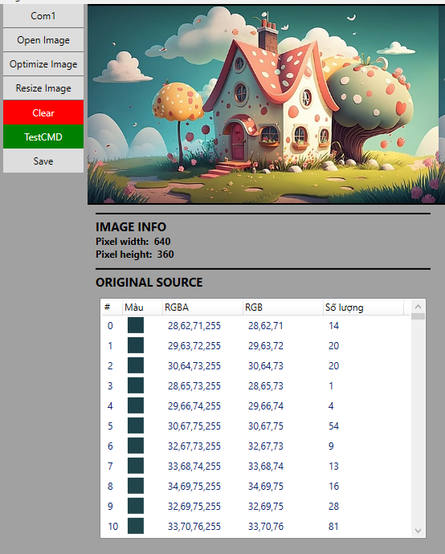



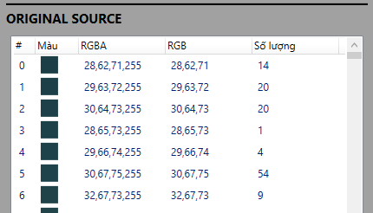
Khi có sự kiện chuột hover
Export to single frame of Spr file
Import to next frame of Spr work space

Slide 2
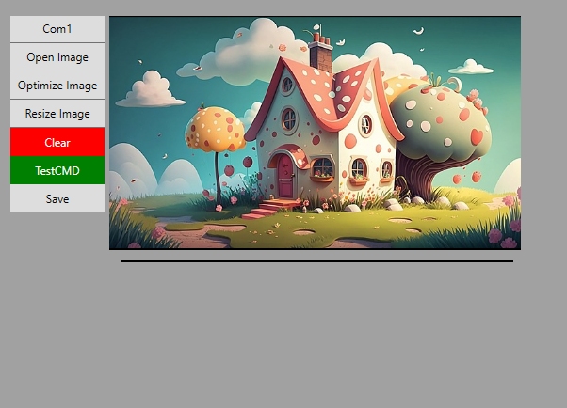



SPR edit mode
File head info
Global width: 640
Global height: 360
Global offset X: 0
Global offset Y: 0
Colors count: 256
Directions count: 1
Frames count: 1 Frame: 0
Frame width: 640
Frame height: 360
Frame offset X: 0
Frame offset Y: 0
Interval: 1 (27in=36fps)
Frame info

Slide 3

SPR edit mode
File head info
Global width: 650
Global height: 360
Global offset X: 0
Global offset Y: 0
Colors count: 256
Directions count: 1
Frames count: 1 Frame: 0
Frame width: 640
Frame height: 360
Frame offset X: 0
Frame offset Y: 0
Interval: 1 (27in=36fps)
Global width tăng từ 640 lên 650
Chiều rộng ảnh tăng, nhưng chiều cao hiện tại đang giữ nguyên
Frame info

Slide 4

SPR edit mode
File head info
Global width: 650
Global height: 370
Global offset X: 0
Global offset Y: 0
Colors count: 256
Directions count: 1
Frames count: 1 Frame: 0
Frame width: 640
Frame height: 360
Frame offset X: 0
Frame offset Y: 0
Interval: 1 (27in=36fps)
Global width tăng từ 640 lên 650
Global height tang từ 360 lên 370
Frame info

Slide 5
SPR edit mode
File head info
Global width: 640
Global height: 360
Global offset X: 0
Global offset Y: 0
Colors count: 256
Directions count: 1
Frames count: 1 Frame: 0
Frame width: 640
Frame height: 360
Frame offset X: 0
Frame offset Y: 0
Interval: 1 (27in=36fps)
Frame info

Slide 6
SPR edit mode
File head info
Global width: 640
Global height: 360
Global offset X: 50
Global offset Y: 0
Colors count: 256
Directions count: 1
Frames count: 1 Frame: 0
Frame width: 640
Frame height: 360
Frame offset X: 0
Frame offset Y: 0
Interval: 1 (27in=36fps)
Global offset tăng từ 0 lên 50
Frame info

Slide 7
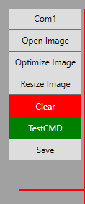
SPR edit mode
File head info
Global width: 640
Global height: 360
Global offset X: -50
Global offset Y: 0
Colors count: 256
Directions count: 1
Frames count: 1 Frame: 0
Frame width: 640
Frame height: 360
Frame offset X: 0
Frame offset Y: 0
Interval: 1 (27in=36fps)
Global offset giảm từ 0 xuống -50
Frame info

